Slide 1
I.C.T. and Language Learning: An integrated approach
An introduction to GaelNet
Edmund Ellison
eLearning consultant | Joomla Web Developer | Teacher
Web: http://www.gaelnet.info
Blog: http://eellison.edublogs.org
Email: ellison-e@live.co.uk
Twitter: gaelnet
Skype: gaelnet

Slide 2


Web Technology & GaelNet
GaelNet is a multimedia website which caters for modern language teachers.
The website incorporates some of the leading technologies, modules and components available on the web to promote blended learning.
GaelNet is delivered using a complex and modern content management system and has the potential to expand into further areas of interest in the future, bringing teachers and students together.

Slide 3
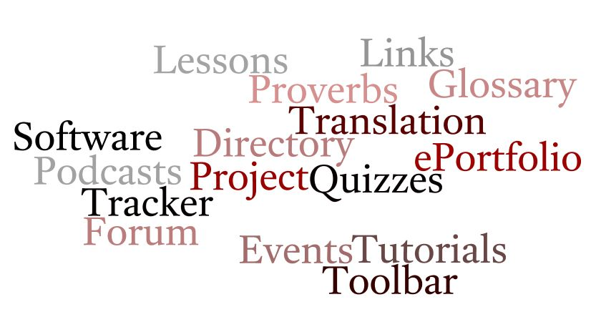
Services on GaelNet

Slide 4
A sample of what’s available:
GaelNet currently provides a list of exciting features including the ability to:
Upload documents, podcasts and videos
Link to YouTube videos
Post on forums
Submit articles & reviews
Submit web links to an educator links directory
Manage groups
Make use of modern language specific and generic tools

Slide 5
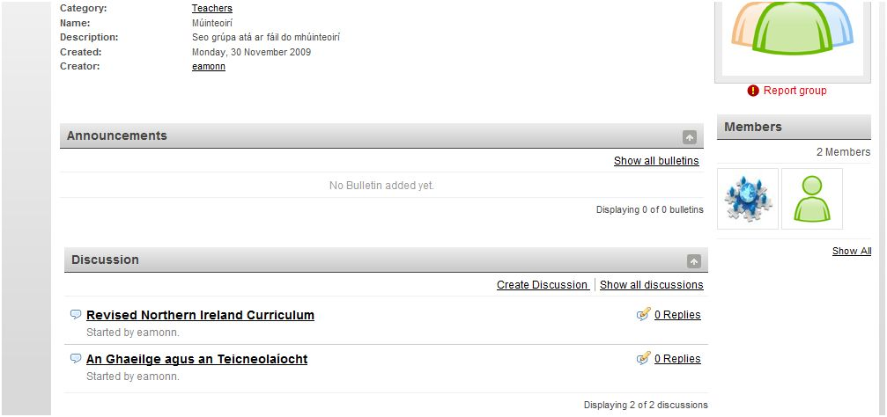
Groups
Need somewhere to chat with colleagues? Why not use a dedicated private group?

Slide 6
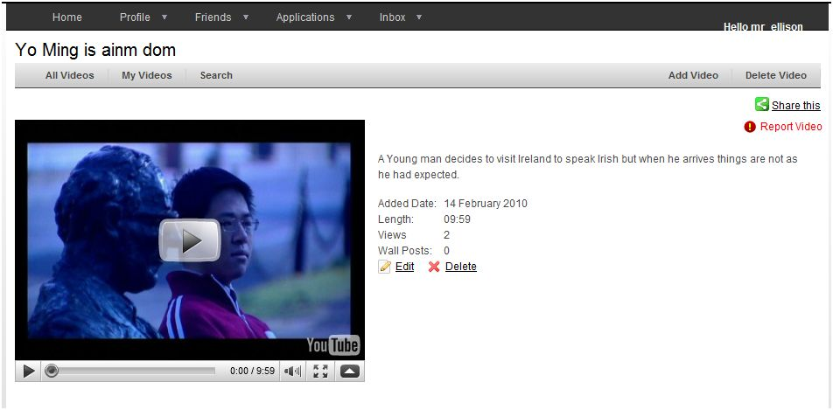
Videos
Upload videos or link to YouTube content

Slide 7
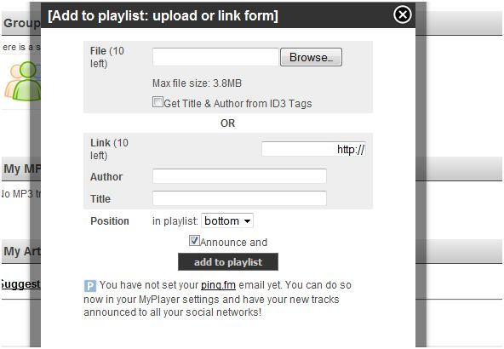
Podcasts
Know how to use Audacity after today? Why not upload your podcast for free for your students?

Slide 8
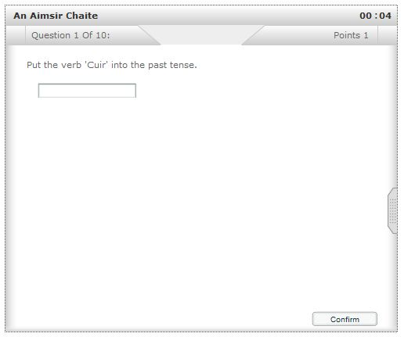
Quiz
Students can take quizzes when they are available

Slide 9
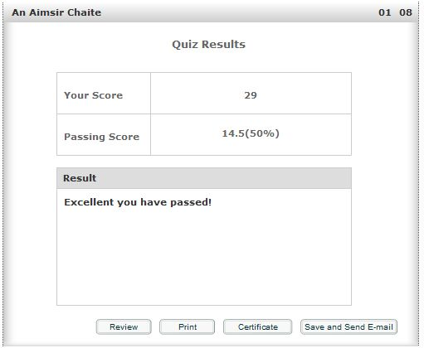
Quiz
Instant feedback!

Slide 10
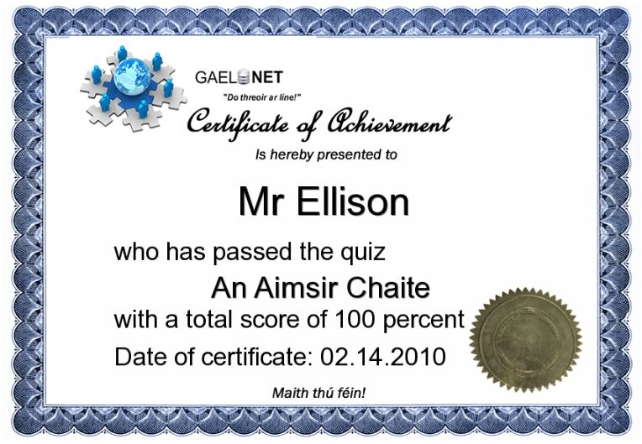
Quiz
What about a certificate to promote A.F.L?

Slide 11
What’s to come?
Online eTutor area which provides some of the following features:
Teachers can moderate students’ work
Students have access to an online ePortfolio with a blog, a calendar, a file directory area, links, an events tracker, an ability / experience record area
Teachers set up a class and students can enrol automatically with a click of a button!
Designed around the 5 e’s concept of Revised Curriculum for I.C.T requirements.

Slide 12
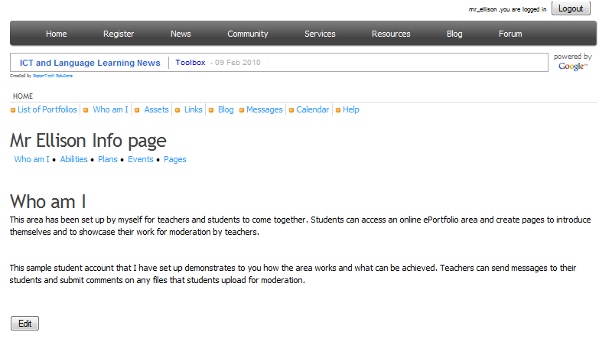
Sneak Preview

Slide 13
A sneak preview
Teacher Toolbox software is currently entering final testing stages and is special software that I have designed that runs on C2K teacher accounts.
In short it is a name selector, verb selector, group picker and countdown timer all rolled into one
Release date: TBC.

Slide 14


Slide 15

Online course for MFL teachers
Training on Audacity, Hot Potatoes, Wordle, Wordlearner and more all from one place!
Soon you’ll be able to watch eLearning training videos from you own computer by logging onto GaelNet and enrolling on the new course which will provide training and resources for language teachers on integrating I.C.T into the classroom.
More news on this exciting service will be provided at a later date.

Slide 16
How do I register?
Simple, to get started simply click on the link below and visit the registration page to sign up as an Educator.
Registration is free for students and teachers.
Visit www.gaelnet.info and become part of the online modern language community for teachers and students.

Slide 17

Any questions?

Slide 18
I.C.T. and Language Learning: An integrated approach
An introduction to GaelNet
Edmund Ellison
eLearning consultant | Joomla Web Developer | Teacher
Web: http://www.gaelnet.info
Blog: http://eellison.edublogs.org
Email: ellison-e@live.co.uk
Twitter: gaelnet
Skype: gaelnet

